Slide 1
Unmoderated Remote Panel Studies
001067207
Xuanhe Wang

Slide 2
Introduction
Many UX teams rely on remote usability testing to efficiently get design feedback from users. There are two types of remote user testing:
Moderated remote testing involves a researcher meeting with a participant via remote screen-sharing software, which allows the researcher to provide instructions, observe the user’s interaction with the design in real time, and ask followup questions specific to that participant’s session.
Unmoderated remote testing does not require a researcher to attend each test session; instead, a software application provides instructions to users, records their actions, and may ask them predetermined followup questions.

Slide 3
Three Usability-Testing Formats Compared
 | In-person moderated usability testing | Remote moderated usability testing | Remote unmoderated usability testing
Facilitator required | Yes | Yes | No (the testing platform acts as the facilitator)
Ability to ask specific questions | Yes | Yes | No (though you can set up generic followup questions after each task)
Ability to reorder or modify tasks | Yes | Yes | No
Ability to clarify instructions for participants | Yes | Yes | No
Ability to coach or encourage participant to think out loud | Yes | Yes | No (though you can instruct them at the beginning of the session)

Slide 4
Three Usability-Testing Formats Compared
 | In-person moderated usability testing | Remote moderated usability testing | Remote unmoderated usability testing
Testing location required (for example, a usability-testing lab or focus-group facility) | Yes | No | No
Typical cost | High | Low | Low
Session scheduling | Fixed session dates and times | Flexible session dates and times (can be modified depending on participant availability) | No scheduling needed (users participate on their own time)
Typical session length | Can be short (30 min) or long (2-3 hours) | Can be short (30 min) or long (2-3 hours) | Most platforms require short sessions (around 30 min)
Risk of “cheating” or unmotivated participants | Low | Low | High (depending on how participants are recruited)

Slide 5
Is Unmoderated Testing Right for Your Project?
Unmoderated studies do not include any direct interaction between the researcher and the study participants, which is both their biggest benefit and their greatest drawback.
Because there’s no need to schedule an individual meeting with each participant, unmoderated testing is usually much faster than a moderated study. It may be possible to launch a study and receive results within just a few hours. Unmoderated studies also allow you to collect feedback from dozens or even hundreds of users simultaneously. And for international studies, you don’t have to get up at an ungodly hour to match users’ time zone.

Slide 6
However, there are important limitations of unmoderated usability testing:
Early-prototype testing is difficult without a moderator to explain and help participants recover from errors or limitations of the prototype.
Without a moderator, participants tend to be less engaged and behave less realistically in tasks that depend on imagination, decision making, or emotional responses.

Slide 7
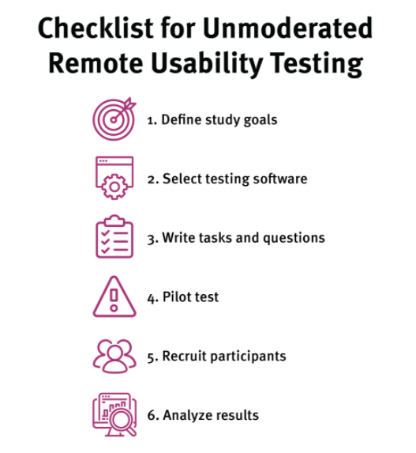

Slide 8
1. Define Study Goals and Participant-Recruitment Criteria
Choosing software should not be the first step in unmoderated research. Before you decide which testing software to use, you should get a clear idea of what you hope to accomplish by doing the study. Then you can select a tool which has the capabilities best suited for your research goals, rather than limiting your study to fit within the technical constraints of a particular tool. Clearly articulated study goals allow you to identify must-have requirements for the testing software.

Slide 9
2. Select Testing Software
For unmoderated studies, the software that administers the test is absolutely crucial to getting useful results. The software must guide the participants through the session and record what happens. It may also control the selection of study participants.
It’s definitely worth your time to thoroughly investigate and pilot test tools, because migrating a study to a different system due to a technical limitation discovered after you launch a study is not fun! (Neither is trying to integrate data collected by two different tools.)

Slide 10
3. Write Task Instructions and Followup Questions
Many unmoderated testing services include study templates with generic example tasks. Don’t blindly copy them. The tasks that you give participants to do on your site or application should be highly specific to your situation. Generic tasks, such as “What is the purpose of this site,” are unlikely to give you good insights: to really assess the usability of your system you will need to write your own tasks.

Slide 11
4. Pilot Test
A pilot test is a trial session that you run before your actual study begins, in order to discover any problems with your study design or procedure.

Slide 12
5. Recruit Participants
There’s no point in watching people use your system if they don’t match your target audience. Make sure you have some control over who participates in the test, either through screening questions, or by recruiting your own participants.

Slide 13
6. Analyze Results
Unmoderated studies can quickly accumulate a LOT of data, so you’ll need an organized, analytical approach to turn this data into actionable insights about your design.

Slide 14
Summary
Unmoderated research requires less work than moderated testing during the session, but it requires meticulous advance planning before the study begins. You can learn more about remote user testing and the relation between this method and in-person testing in the full-day Usability Testing training course, which includes hands-on details on writing tasks, facilitating sessions, and more.

Slide 15
Moderated Remote Usability Studies
Jiaqi Wang 001023711

Slide 16
Introduction&background
What is a Moterated Usability Test:
During a moderated test, you're live, “on the line” with your test participants, guiding them through the tasks, answering their questions, and replying to their feedback in real time.
If the test is moderated, however, the moderator can lead the tester back in the right direction and get the test on track again. While the moderator should never interfere with the tester’s instincts, having a moderator available can salvage a test that would otherwise have flopped.

Slide 17
Why should we use it?
conducting in-person usability tests takes a lot of resources. You need to recruit test participants, set up a testing environment, prepare task scenarios, fill out paperwork, and much more
With remote, unmoderated usability tests, you don’t have to recruit test participants or set up the testing environment. Instead, you simply hand over task scenarios to the usability testing service that’s conducting the tests for you and wait for the results. However, You can’t follow up with test participants during or after the test and test participants might get distracted during the test.
remote, moderated usability testing is a middle ground between in-person and remote, unmoderated usability testing in that it combines the best elements of both approaches. Similar to remote, unmoderated usability testing, you’re able to conduct quick, inexpensive usability tests. And, similar to in-person usability tests, you can gather useful data.

Slide 18
When should you use it?
moderated tests are best used early on in the development process. In the prototyping phase, you can use moderated testing for exploratory research. By prompting participants to brainstorm their thoughts on your prototype, you can gain invaluable information that can save you from spending a lot of design and development time on a product that users don’t understand.
remote moderated usability testing may be a better fit than remote unmoderated testing or in-person moderated testing if:
You want deep insights and rich data
Your participants are busy, geographically distributed, or otherwise cannot travel to a testing location
Your researchers have enough time to meet with each participant individually

Slide 19
Running a remote moderated usability test
Step1 :Set up the test session having the participants sharing their screen
Send out reminders of the session to the participants.(Time, Equipment, App installed, How to join…)
Bring in observers and participants into the session.
Introduce the session.(welcome&thanks, Confirm name pronunciation, collect consent ,begin)

Slide 20
Running a remote moderated usability test
Step2 :Ask interview questiones:
Before the participants share their screen, you may pause before beginning the session and ask the participant a few interview questions that are relevant to the test. You may ask if the participant has ever used this app before or you might ask behavior questions. Things like what kinds of things do you normally shop for online. These questions will give you context about the participants experiences and preferences but it will also make the participant a bit more comfortable talking to you.

Slide 21
Running a remote moderated usability test
Step3 :Start the session
Administer tasks
Reassure the participant

Slide 22
Running a remote moderated usability test
Step4 :Close the session:
Final questions
Thank participants
Thank-you gift
dismiss

Slide 23
Running a remote moderated usability test
Step5 :Discussion& reflection
Test and analyze as planned. Depending on the technology or methodology used, you may also be able to analyze such metrics as task-completion rate, time on task, time on page, clickstream paths, and satisfaction ratings or opinion rankings.

Slide 24
Summary
Remote, moderated usability testing is a hybrid of in-person and remote, unmoderated usability testing. It’s an easy (and cost-effective) way to gather insight directly from the product’s intended users without breaking the bank.
Let’s quickly recap the main steps you need to follow in conducting remote, moderated usability testing:
Select a collaboration tool (with screen sharing and chat functionality) to conduct the usability tests.
Develop a plan to administer task scenarios and instructions to test participants.
On the day of the test, remember to take some time introducing yourself and asking for the participant’s consent to record their test session.

Slide 25
Diary/Camera Studies
001533496
Zechen Song

Slide 26
Introduction
A diary study is a contextual, qualitative, longitudinal research methodology used to capture user behaviors, activities, and experiences.
Diary studies take place over time and offer insight into people’s day-to-day lives. They’re researcher prompted and user generated—meaning your participants follow your instructions and show you their experience in their own words.

Slide 27
When might a diary study be a good fit?
curious about micro-moments and interactions that affect “big decision making.”
see a diversity of experiences and learn how behaviors or perceptions change.
worry direct observers would influence behavior.
want to know more about what motivates someone to act.
want to reach more sensitive populations, where direct observation isn’t an option

Slide 28
Methodology
1. Planning and Preparation.
Define the focus of the study and the long-term behaviors that you need to understand. Define a timeline, select tools for participants to report data, recruit participants, and prepare instructions or support materials.

Slide 29
Methodology
2. Pre-study Brief
Take time up front to get participants ready to log. Schedule a face-to-face meeting or phone call with each participant to discuss the details of the study. Walk through the schedule or calendar for the reporting period and discuss expectations. Discuss the tools they will be using and be sure each participant has familiarized themselves with the technology; answer any questions they may have before beginning.

Slide 30
Methodology
3. Logging period.
To support effective activity logging, provide a simple framework. Be as specific as possible about what information you need participants to log, without stifling natural variability and differences that you cannot plan for. Create clear and detailed instructions for logging. Give users example log entries to help them understand the level of detail you need from them.

Slide 31
Methodology
Two common techniques to collect diary data:
3.1. In-Situ Logging
This method is the most straightforward method to collect data. Participants are asked to log information about relevant activities in the situation they occur.
3.2. Snippet Technique
With this technique, participants only record short snippets of information about activities as they occur. Then, they elaborate on each snippet by providing additional details about the activity.

Slide 32
Methodology
4. Post-study interview
After the study, evaluate all the information provided by each participant. Plan a follow-up interview to discuss logs in detail. Ask probing questions to uncover specific details needed to complete the story and clarify as needed. Ask for feedback from the participant about their experience participating in the study, so you can adjust your processes for the next time.

Slide 33
Methodology
5. Data Analysis
Because diary studies are longitudinal, they generate a large amount of qualitative data. Revisit your research questions, then take a deep breath and dig into all of the rich insights you’ve collected to find the answers. Evaluate the behaviors you’ve targeted throughout the study.

Slide 34
Motivating participants
Getting the insights, you need will take some involvement with participants throughout the study.
Diary studies require time and dedication from participants.
Plan to check in with participants or give periodic reminders as needed (each day or every few days). To ensure you get the level of involvement you need from participants, provide a compensation that will keep them engaged.

Slide 35
More Tips
Plan for an appropriate reporting period.
Recruit dedicated users.
Be on top of the data as it comes in.
Conduct a pilot study

Slide 36
Conclusion
While diary studies can require more time and effort to conduct than other user-research methods, they yield very useful information about customers’ real-time real-life behaviors and experiences.
Diary studies allow you to get a contextual understanding of users’ behavior and experiences over time.

Slide 37
Eyetracking
Hao Fu 001586014

Slide 38
Introduction
Eyetracking equipment can track and show where a person is looking.
To do so, it uses a special light to create a reflection in the person’s eyes.
Cameras in the tracker capture those reflections and use them to estimate the position and movement of the eyes.
That data is then projected onto the UI, resulting in a visualization of where the participant looked.

Slide 39
Tips in study
In an eyetracking study, the tracker has to be calibrated for each participant. Every individual has a different eye shape, face shape, and height.
As a consequence, the tracker has to “learn” each participant before it can follow their gaze. Once the machine is calibrated, the participant has to stay roughly in the same position -- moving too far side to side or leaning in or out can cause the tracker to lose calibration.

Slide 40
Four main patterns
Eyetracking research shows that there are 4 main patterns that people use to scan textual information on webpages: F-pattern, spotted pattern, layer-cake pattern, and commitment pattern.
F-pattern
Spotted pattern
Layer-cake pattern
commitment pattern

Slide 41
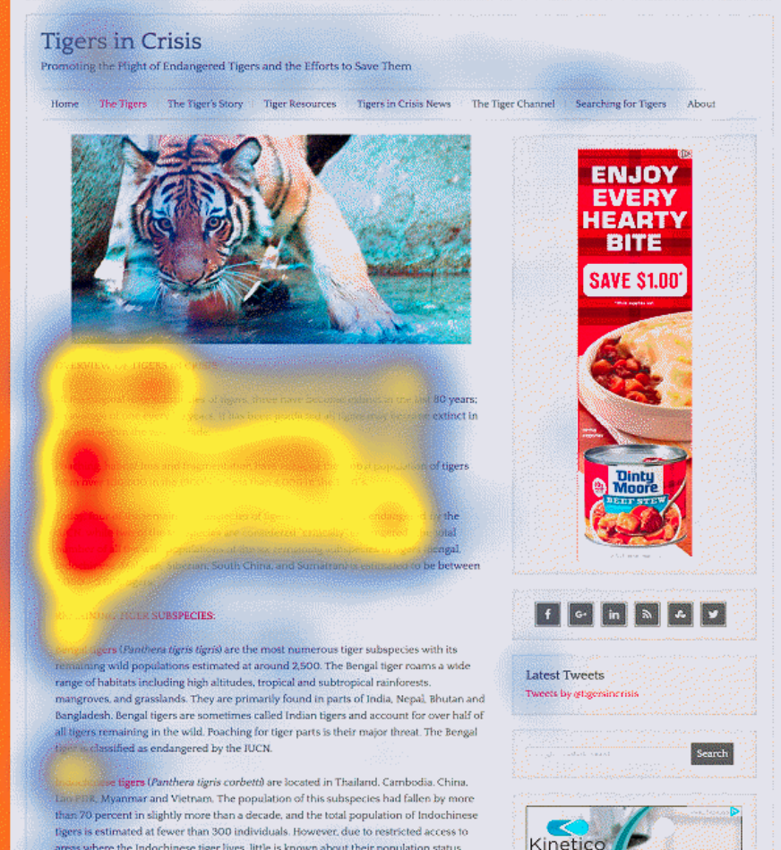
F-Pattern
In the absence of subheadings and bullets, users tend to fixate on the words toward the beginning of lines and toward the top of the page.
This scanning behavior results in an eyetracking pattern that resembles the capital letter F — hence, our name for this pattern. In left-to-right languages, text on the left and towards the top of the page is read more than text on the right or towards the bottom of the page.

Slide 42
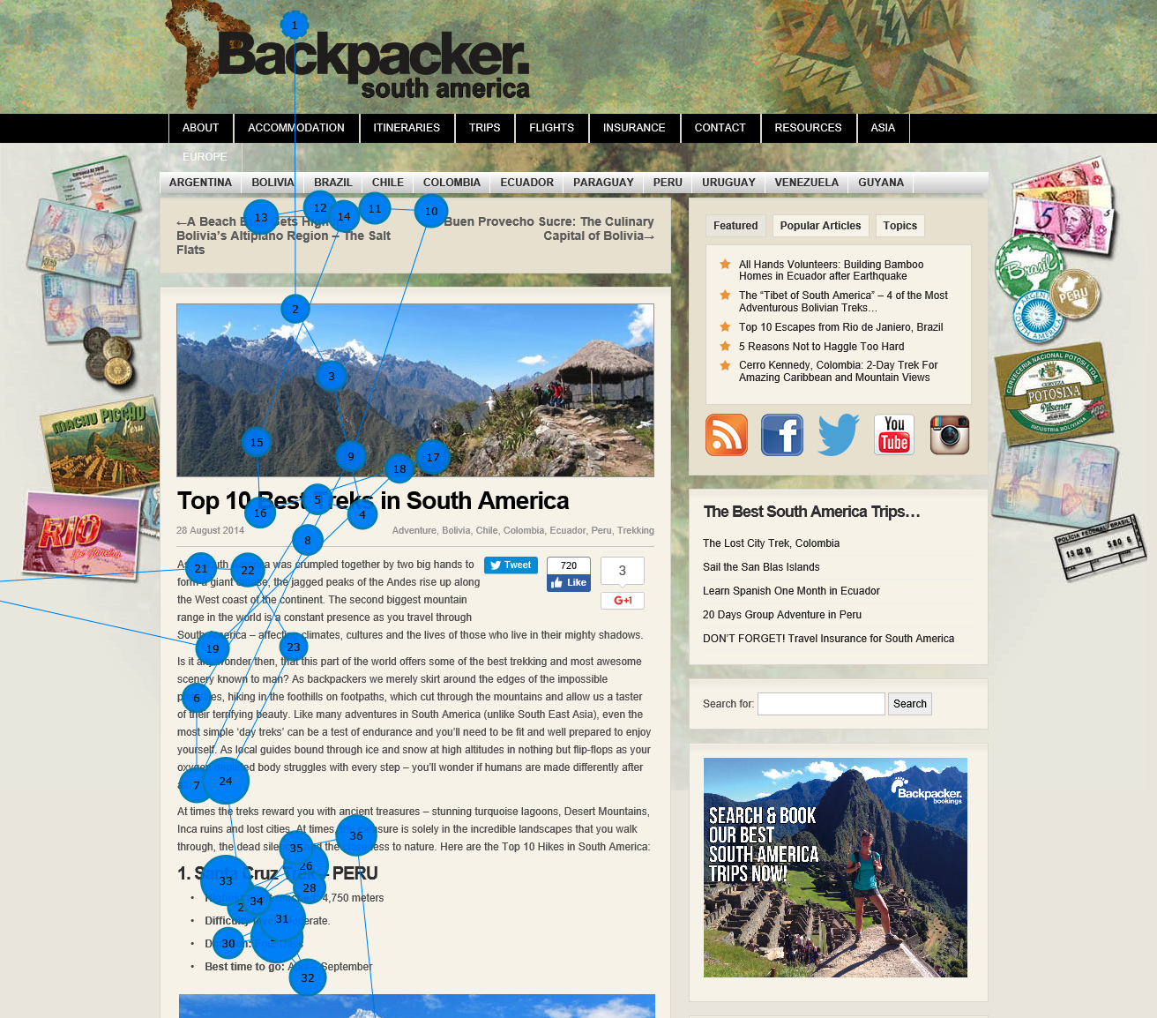
Spotted Pattern
The spotted scanning pattern involves fixating on specific words or chunks of words spread throughout the page. The user chooses words because they visually stand out in the text. They are styled differently (e.g., links, differently colored words, bolded words, bulleted lists).

Slide 43
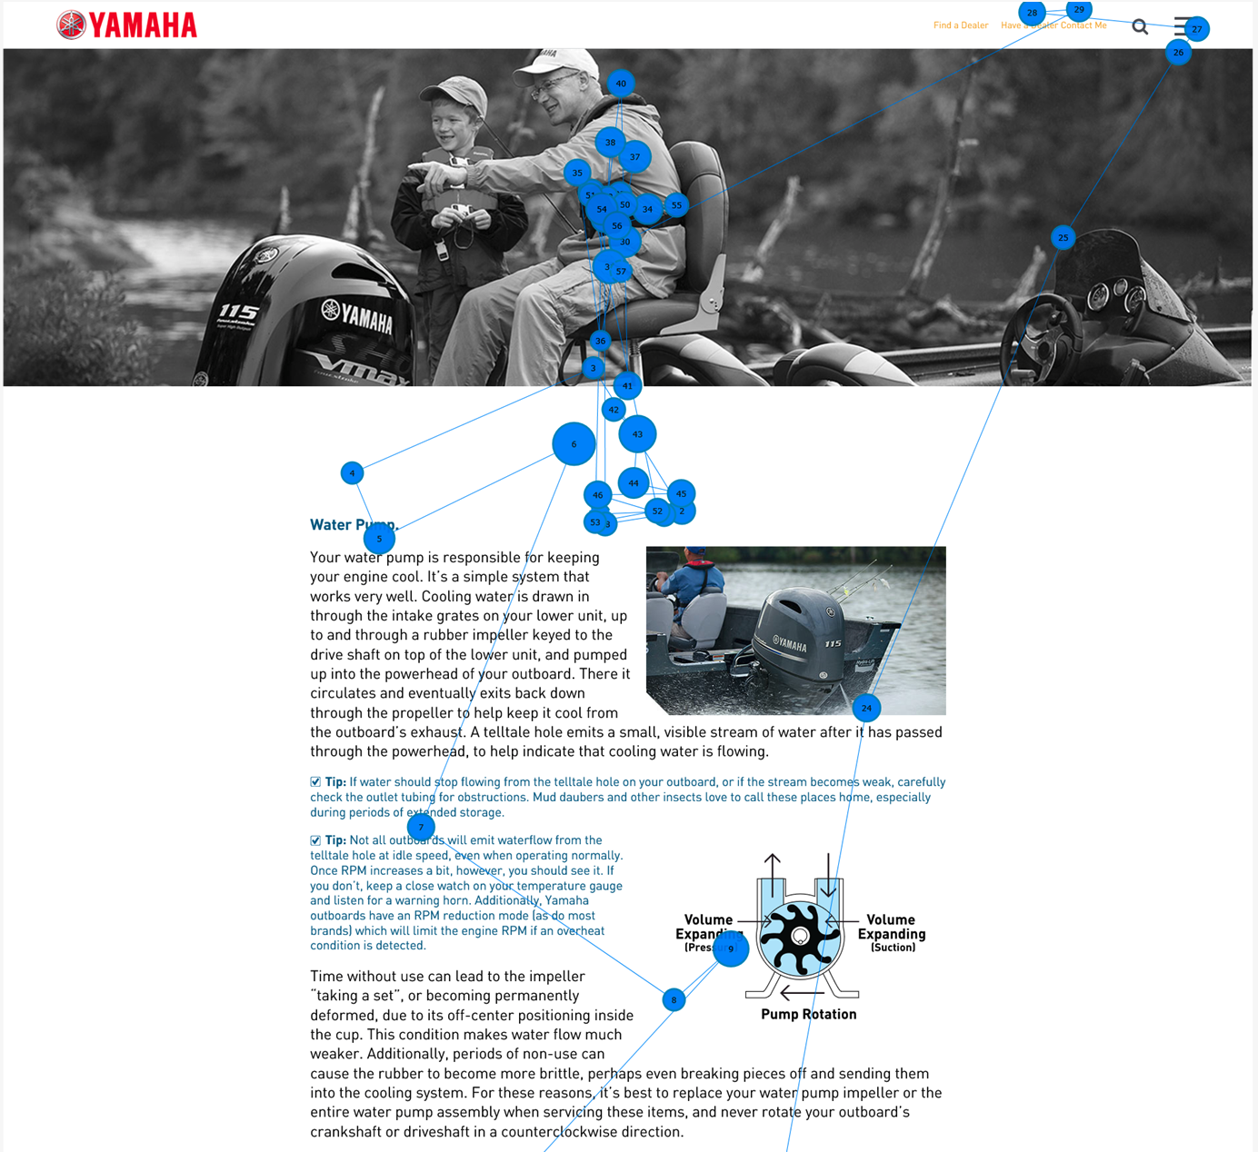
Layer-Cake Scanning Pattern
The layer-cake scanning pattern consists of fixations placed mostly on the page’s headings and subheadings. There are few other fixations on the text in between — that is, until users locate the heading they are interested in; at that point, they usually read the accompanying body text below.
In an eyetracking heatmap or gaze plot, the layer-cake pattern looks like a set of horizontal stripes and blank spaces between them, resembling a layer cake (with cake on a level, then frosting, then cake, and so on).

Slide 44
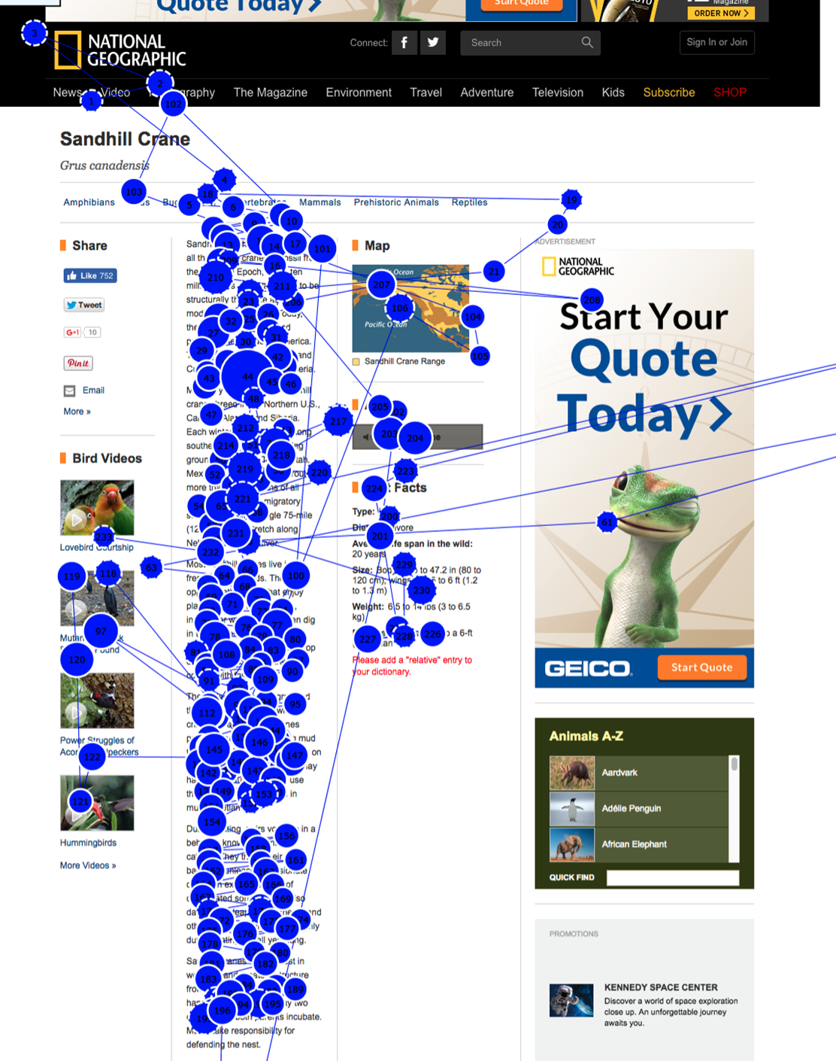
Commitment Pattern
The commitment pattern demonstrates traditional reading, not scanning. In this pattern, users fixate on all or most content words in the text passage. This pattern usually occurs when users are very interested or very motivated to read the content.
The commitment pattern usually leads to the best comprehension.

Slide 45
In conclusion
Eyetracking research helps us to see the details of how users look at content and how they choose to skip or read it.
When you write, edit, or organize text on a webpage or in an app, keep in mind that how you present your content is likely to favor one of the four text-scanning patterns: the F-pattern, spotted, layer cake, and commitment patterns.
Know that most users will read very little from a wall of text; support them by chunking your content into sections and bulleted lists, by using meaningful subheadings, and by special visual styling for keywords.

Slide 46
Improvements to the website through eyetracking
Clean, clear close-up images draw more visual attention. While abstract art images may make your site look interesting, they won't attract much attention from readers. If you need to use these images, make sure they are clear and easy to read. It is important to note that the images associated with real "people" are "superior" to the so-called model images.
Headlines catch the eye. When browsing a web page, the first thing a reader will notice is the title. Ensure that all relevant links on the page are unblocked and effective, so that readers can smoothly search through the site.
Short paragraphs are more expressive than long paragraphs. Web information is intended for the majority of unconnected users who emphasize quick browsing. Keep messages short paragraphs and sentence structures unless the context requires them, such as the product description on this e-commerce site.

Slide 47
Ads at the top and left of the page are more eye-catching. If you need product placement on your site, try to integrate them into the top left of the page so they attract the most visual attention. Of course, just because users notice these ads doesn't mean they'll click on them. So don't sacrifice your site design for the sake of advertising attention.
Placed at the top of the page, navigation tools will work better. Ideally, you don't want your readers to be satisfied with just looking at the initial page when they open your site, you want them to look at something else they're interested in. Placing the navigator at the top of the page makes it easy for users to find the desired content using the tool.
Use the white space. While it's tempting to fill every inch of your web page, it's actually better to leave some of your site free. Web sites can overwhelm users with too much information, and they can forget much of what's on offer. So keep the page simple and give the reader some visual space to relax.

Slide 48

Any Questions ?

Slide 49


